Slide 1
TEAM-IFPTE Local 161 Tentative Agreement Information Meetings
Brandon: Royal Oak Inn – July 22
Winnipeg: Masonic Temple – July 23
Winnipeg: Fairmont Hotel – July 24

Slide 2
Agenda
Welcome (2 min)
Memorandum of Agreement (15 min)
Voting Procedure (5 min)
Q & A (20 min)
Notes:
2

Slide 3
2013 Collective Bargaining
Three-year agreement
Pay increase retroactive to February 20th
Unless otherwise indicated, all changes effective on ratification of the Collective Agreement

Slide 4
TEAM’s Objectives
We made proposals on the following:
- Compensation
- Benefits
- Working Conditions
- Workplace Problems and Issues

Slide 5
Wages
All increases are on base:
- Feb 20th 2013 – 2%
- Feb 20th 2014 – 2%
- Feb 20th 2015 – 1.75%
No changes to variable pay

Slide 6
Benefits
$80 for eye examination every two years
Renewal of $100,000 per year contribution to Blue Cross Health Plan (subject to IBEW & CEP agreement)

Slide 7
PLDs and Vacation
No change to PLDs and vacation for existing TEAM members
Three PLDs for employees new into TEAM
New MTS employees work an extra year to get three weeks vacation, and vacation capped at six weeks

Slide 8
Call-out
No change to minimum two-hours for work done at the worksite or Duty Manager pay
New wording: “…where an employee is called out to perform work which does not necessitate reporting to workplace, but instead can be performed remotely or at the employee’s residence, the employee will be paid at applicable overtime rate as follows:”

Slide 9
Call-out
If the call occurs: - Weekdays: 5 pm - 11 pm minimum 15 min
- At night: 11 pm - 7 am minimum 1 hour
- Weekends/holidays: 7 am-11 pm min 15 min

Slide 10
Compressed Work Week
A formal arrangement by mutual agreement
Work additional hours per day in order to reduce the number of days in the work week or month

Slide 11
Pay Schedules
Obsolete schedules deleted
“C” merged into “B”; no change in pay.
“D” (IT) renamed “C”
Members on grad schedules to be transitioned to “B” and “C” schedules
Notes:
Deleted:
Acting Rate for Maximum of Group in Appendix B, C, & D
Hiring Rates — University Graduates/Community College in Appendix B, C, & D
Traffic, Engineering, Sales, Technical Pay Guide in Appendix B
Grad schedules

Slide 12
New - Entry Level Positions
MTS to first post 302 rated Associate positions internally at least once a year
Internal applicants selected consistent with Article 8 - Postings
If requirement to fill vacant positions not met Company can fill in any manner it chooses
Definition of Student Employee added and employment not limited to summer work only
Notes:
Student Employee - is an employee who is enrolled in a college or university who: may work during the summer months and/or academic year and may work less than the basic weekly hours of work.

Slide 13
Contracting-in
New Letter of Understanding:
- Clarity on contracted work
- Opportunity for employees to do the work
- Time limits
- Maximum number of contractors tied to the number of employees in TEAM
- Expanded reporting requirements
- Financial penalties for exceeding cap

Slide 14
Other
Actors: From outside TEAM’s jurisdiction now go straight to TEAM scale and work TEAM hours
Sales Bonus Plans: Plan review and new reporting requirements
Job Evaluations: Opportunity for debriefing
Hours of Work: “… in accordance with the Canada Labour Code.”

Slide 15
Other
Out-of-Scope (Appendix “A”): Expanded reporting requirements
Arbitration: Where parties agree to single Arbitrator, selected by mutual consent
Housekeeping e.g. Company name change, typos etc.
Complete Memorandum of Agreement is available on our website

Slide 16
Why Recommended?
We believe it’s the best settlement we could achieve without initiating a strike
MTS indicated a “Final Offer” would be less than the offer before you
TEAM deemed it appropriate to give you the opportunity to vote on an offer before we gave notice of strike action

Slide 17
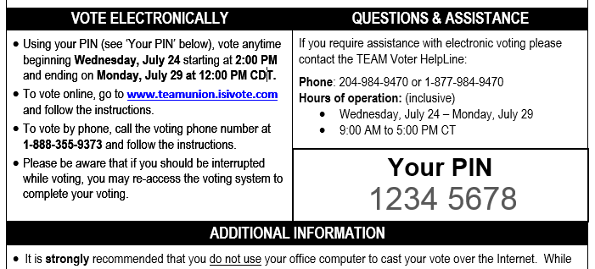
Ratification eVote
eVote email 2 pm Wednesday July 24th
Detailed instructions & PIN in the email:
Notes:
eVote, The Company intelivote Systems Inc is a Canada Industrial Labour Board approved vendor, and is used by Federal Government and other unions.
Email subject line: “Voting Instructions TEAM-IFPTE Local 161 Ratification Vote” from Voter Info.

Slide 18
Ratification e-Vote
The question:
Do you accept the Memorandum of Agreement dated July 16, 2013?
Important: A ‘No’ vote is a vote to reject the Memorandum of Agreement and authorization for job action including a strike.
YES
OR
NO

Slide 19
Ratification eVote
Vote via Internet or phone
Helpline number will be provided
Voting deadline: noon Monday, July 29th
Results memo later that afternoon

Slide 20
Thank You!

Slide 21
Q & A
204-984-9470
team@teamunion.mb.ca
Follow us on Facebook and Twitter
facebook.com/teamunion161
twitter.com/teamunion161

