Slide 1
TEAM-IFPTE Local 161 2017 General Meetings
October 30 – Winnipeg (Corydon/Osborne)
October 31 – Winnipeg (Downtown)
November 2 – Brandon

Slide 2
Agenda
Welcome
Reports:
President, Misty Hughes-Newman
Finance, Bob Linsdell
Member Advocacy:
Erin Spencer
Dave Sauer
Bob Linsdell
Guest speaker:
Paul Shearon, IFPTE Secretary-Treasurer
Q&A
Notes:
2

Slide 3
President’s Report
Misty Hughes-Newman
TEAM has represented supervisors, managers and other professionals at MTS since 1972.
In 2006 members voted to affiliate with the IFPTE.
The IFPTE advocates on behalf of over 80,000 members in Canada & US, including:
Over 700 employees at the City of Winnipeg
8,000 energy professionals in Ontario
Other highly educated and skilled members include NASA scientists, administrative judges, analysts, attorneys, accountants, to name just a few.
Notes:
3

Slide 4
President’s Report
Misty Hughes-Newman
Unlike Locals in most Unions, we have autonomy to run things as best fits our needs:
Elected ten-member volunteer Board
Three full-time staff
Legal counsel, Cochrane Saxberg
IFPTE support from Manitoba based representative.
Member involvement:
Workplace Health & Safety Committees
Scholarship Committee
Feedback and Intelligence
Notes:
4

Slide 5
President’s Report
Misty Hughes-Newman
Many challenges and concerns, especially around:
Job security
Workload and mental health
Jobs in TEAM’s jurisdiction have been cut by:
Over 30% since January 2015
Over 20% since January 2016
TEAM membership is just over 800 today.
Company has agreed to meet with TEAM leadership on topics of most concern.
Notes:
5

Slide 6
Financial Report Bob Linsdell
Auditors: ONBusiness Chartered Professional Accountants Inc.
Budget reviewed and approved by the Board.
The Board reviews our income and expenditures at least six times a year.
Audited Financial Statement is available to members.
Notes:
6

Slide 7
Financial Report Bob Linsdell
Income
Membership Dues* $ 1,038,614
Investment Income $ 64,297
Contractor Dues $ 30,865
IFPTE office contribution $ 3,200
----------- $ 1,136,976
*As a percentage of pay, TEAM dues are the lowest amongst the unions in Bell MTS.
Notes:
7
7

Slide 8
Financial Report Bob Linsdell
Expenses
Salaries, wages & benefits $ 371,049
Legal and arbitrations $ 320,746
IFPTE, MFL & WLC memberships $ 106,845
2016 negotiations $ 49,187
Meetings: members, Board & office $ 40,213
Office lease $ 34,811
Seminars, training & conventions $ 34,378
All other expenses $ 73,308 ----------- $ 1,030,537
Notes:
8
8

Slide 9
Financial Report Bob Linsdell
Balance at December 31st, 2016
General Fund $ 1,625,655
Defence Fund $ 1,732,036
7,027 MTS shares @ $37.96 $ 266,745
Other stock investments $ 68,804
----------- $ 3,693,240
Overall balance up by $166,000 over 2015.
Office staffing down from 4 in 2016 to 3 today.
Expect to end 2017 with similar balance to 2016.
Notes:
9
9

Slide 10
Member Advocacy
Erin Spencer
Member issues since October 2016:
48 new complaints; 27 resolved
Up 12.5%
15 new grievances; 5 resolved
Up 40%
11 grievances at arbitration stage
3 arbitrations scheduled
Overtime pay grievance at judicial review
Notes:
10

Slide 11
Member Advocacy
Erin Spencer
Matters outside the grievance process:
Respectful Workplace complaints
Two Human Rights complaints
1 nearing conclusion and 1 recently filed
Privacy complaint
Wide ranging advice and answers
A sounding board for dealing with difficulties in the workplace

Slide 12
Member Advocacy
Erin Spencer
Main issues in the individual grievances:
Job postings
Pre-screening and non-selection
Demotions
Respectful workplace
Discrimination and failure to accommodate

Slide 13
Member Advocacy
Erin Spencer
Main issues in the policy grievances:
Acting Appointments
Opportunities not posted and pay
Contractors
Reporting concerns
Net Credited Service dates

Slide 14
Member Advocacy
Erin Spencer
Other notable issues:
Uncertainties resulting from BCE purchase of MTS
Excessive workloads
Impact of work stress on Members
Role confusion and overload
Reclassification of contractors to “outsourcing”
VRTIP under threat of layoff, then bring back to do “outsourced” contract work!
Notes:
14

Slide 15
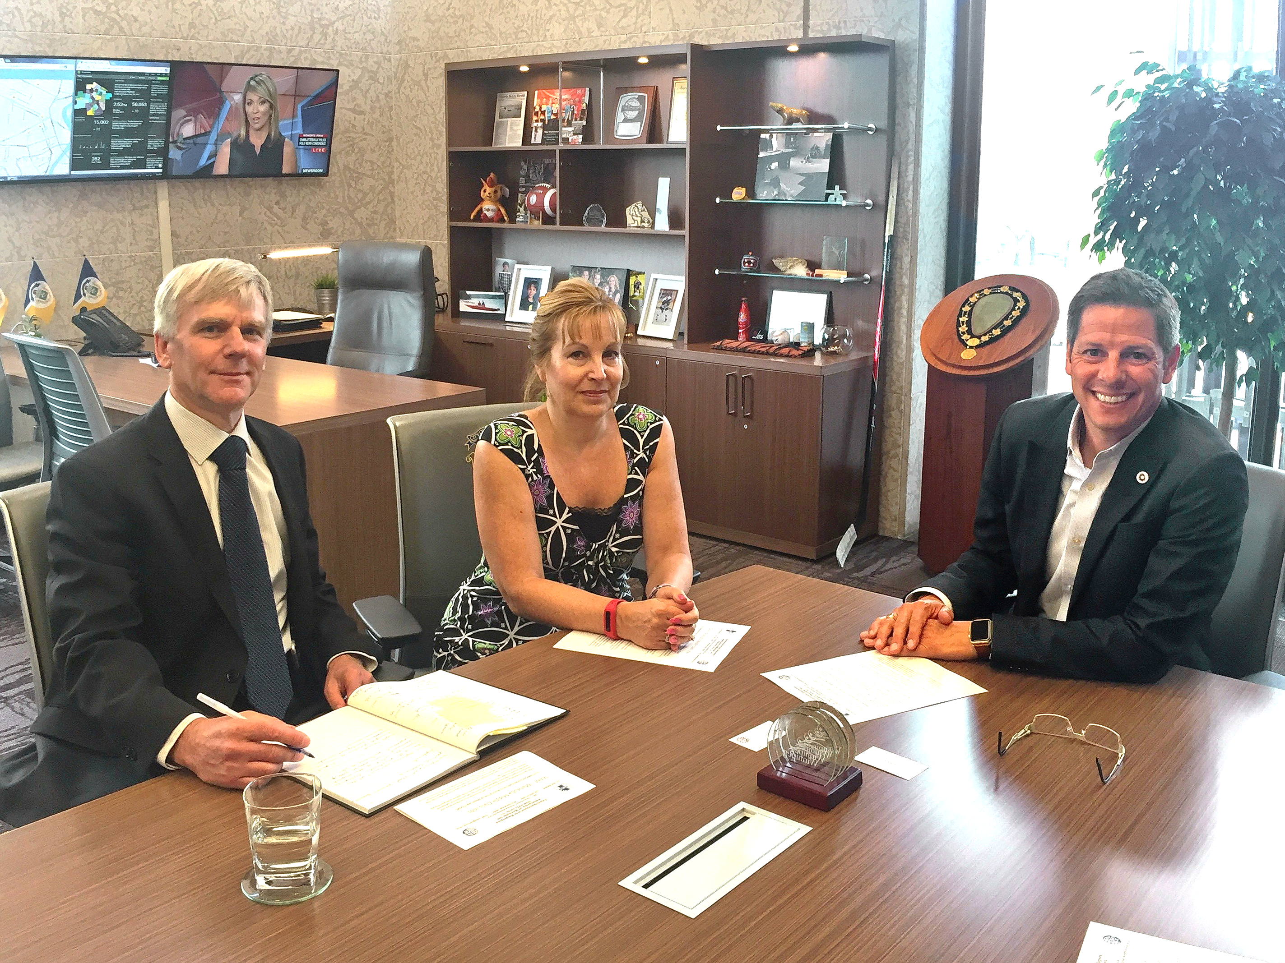
Member Advocacy
Dave Sauer
In response to the downsizing following the announcement of the takeover of MTS by Bell, TEAM-IFPTE Local 161 embarked on a lobbying campaign over the summer, and into the fall, to draw attention to the job losses and encourage Bell to live up to its promise to Manitoba.
Bob Linsdell and Misty Hughes-Newman meeting with Winnipeg Mayor Brian Bowman
Notes:
15

Slide 16
Member Advocacy
Dave Sauer
Advocate on behalf of TEAM-IFPTE Local 161 with Bell MTS.
Discuss the importance of local jobs to the Manitoba economy with key stakeholders.
Promote the information technology and telecommunications sector as a key component of Manitoba’s diverse economy.
Notes:
16

Slide 17
Member Advocacy
Dave Sauer
A total of 41 elected representatives and business leaders from all three levels of government (municipal, provincial, and federal) met with TEAM-IFPTE Local 161.
21 provincial MLAs
14 municipal Councillors
3 federal MPs
In addition to elected officials, TEAM-IFPTE Local 161 also met with a representative of the federal Ministers’ Regional Office, and the Business Council of Manitoba.
Notes:
17

Slide 18
Member Advocacy
Dave Sauer
TEAM-IFPTE Local 161 received an overwhelmingly supportive response from elected officials regarding our concerns.
Support crossed all party lines.
They volunteered to speak with Bell MTS directly.
They volunteered to speak with Economic Development Winnipeg.
Some also offered advice regarding outreach to the business community.
Notes:
18

Slide 19
Member Advocacy
Dave Sauer
Next steps:
Continue meeting with elected officials.
Work with the IFPTE’s Legislative Department.
Engage membership as needed.
Notes:
19

Slide 20
Member Advocacy 2018
Bob Linsdell
Next pay increase, February 20th: 2.0%
Prepare for the 2019 round of negotiations
Ready to respond:
Dedicated Board and an active membership
Financially sound
Experienced staff and legal advisors
Support beyond TEAM:
IFPTE head office and other Locals
Manitoba Federation of Labour
Winnipeg Labour Council
The Manitoba community
Notes:
20
20

Slide 21
Member Advocacy
Paul Shearon
IFPTE Secretary-Treasurer
- Keeping jobs in Manitoba -
Notes:
21
Our guest speaker today comes to us from Washington DC. Paul Shearon is the Secretary-Treasurer of the International Federation of Professional and Technical Engineers, having been unanimously elected at IFPTE Convention in July, 2006.
Prior to his current tenure, Paul served as Organizing Director for IFPTE’s largest Local, the Society of Professional Engineering Employees in Aerospace (Local 2001). He ran successful organizing drives in Seattle and Wichita bringing union representation to over 5,000 employees. He has taught as a teaching fellow for the American Federation of Labor and Congress of Industrial Organizations Organizing Institute, and was a guest speaker at the International Conference for Professional Engineer and Scientist Organizations in Copenhagen Denmark in 2003.
During his career, Paul worked for the Lawrence Livermore National Laboratory, Lockheed Missiles and Space Company Advanced Systems Development, Stanford Research Institute and the Boeing Company. He worked as a Numerical Control Programmer, heading up the programming for critical components Boeing's 777 aircraft.
Paul is as an ardent, unrelenting campaigner for the rights of working people, especially the members of the IFPTE.

Slide 22
Q&A
204-984-9470
1-877-984-9470
team@teamunion.mb.ca
www.teamunion.mb.ca
Join us on Facebook and Twitter
facebook.com/teamunion161
twitter.com/teamunion161
Notes:
22

